Slide 1

PHY 1010U Fall 2019
PHYSICS I

Slide 2
Land Acknowledgement
The university is proud to acknowledge the lands and people of the Mississaugas of Scugog Island First Nation which is covered under the Williams Treaties. We are situated on the Traditional Territory of the Mississaugas, a branch of the greater Anishinaabeg Nation which includes Algonquin, Ojibway, Odawa and Pottawatomi.

Slide 3
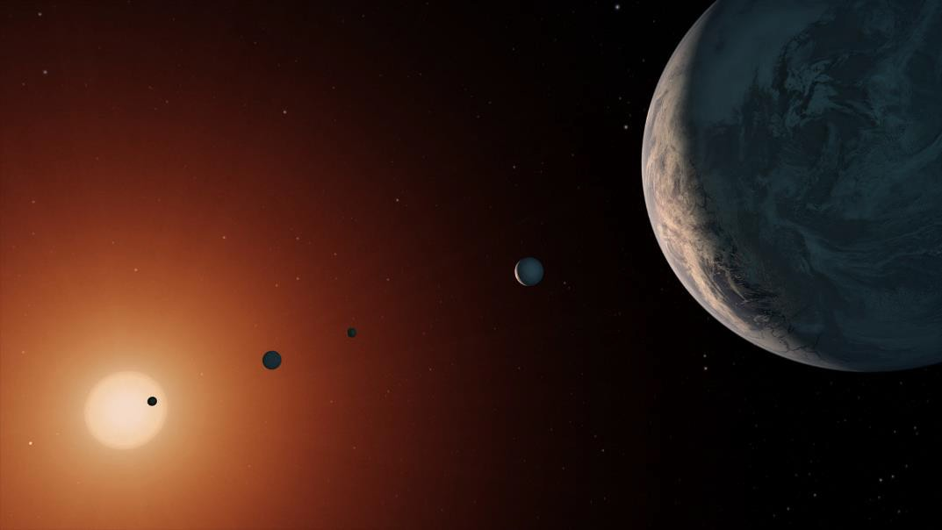
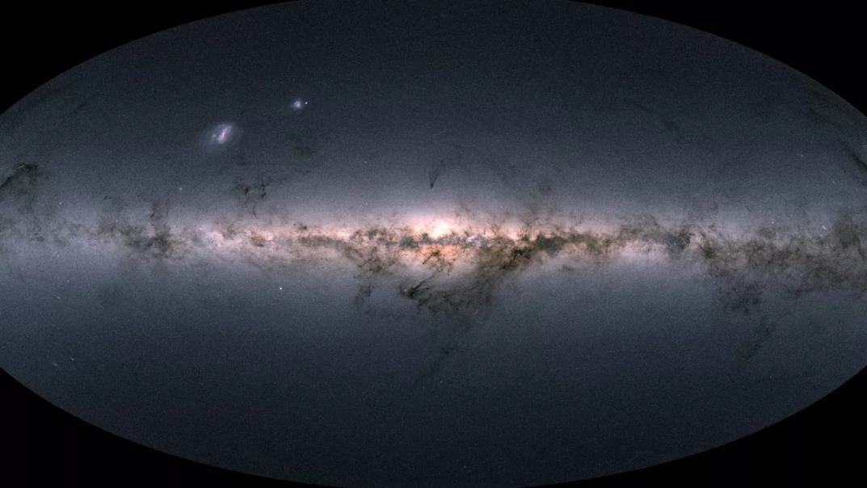
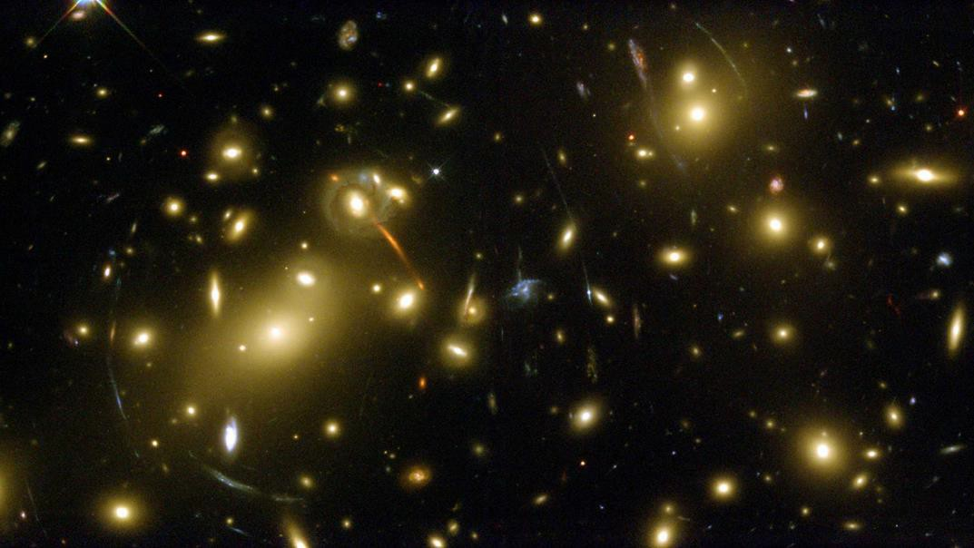
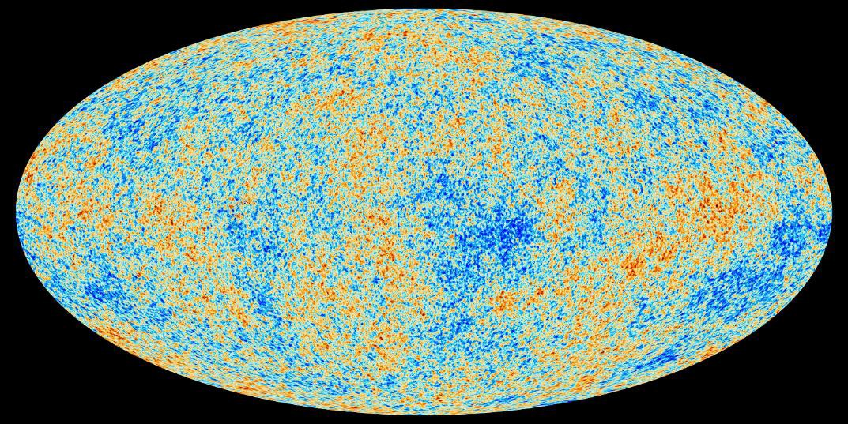
What is Physics?
From the largest scales …

Slide 4
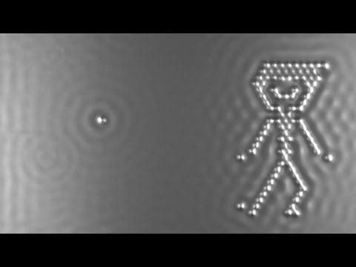
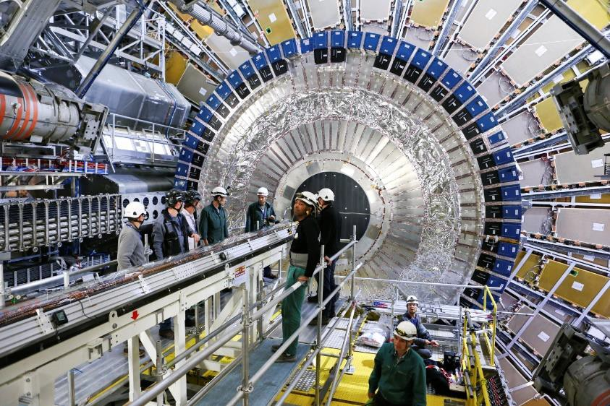
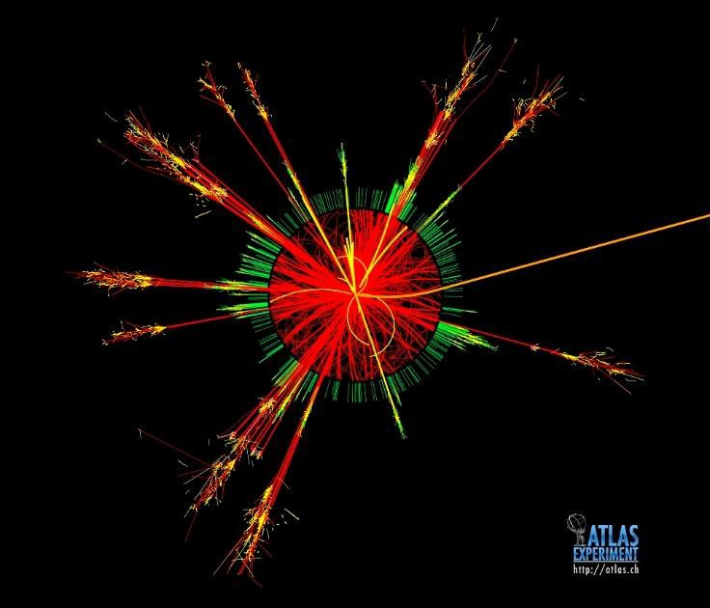
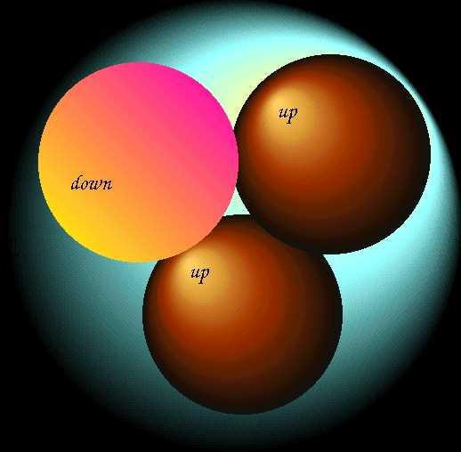
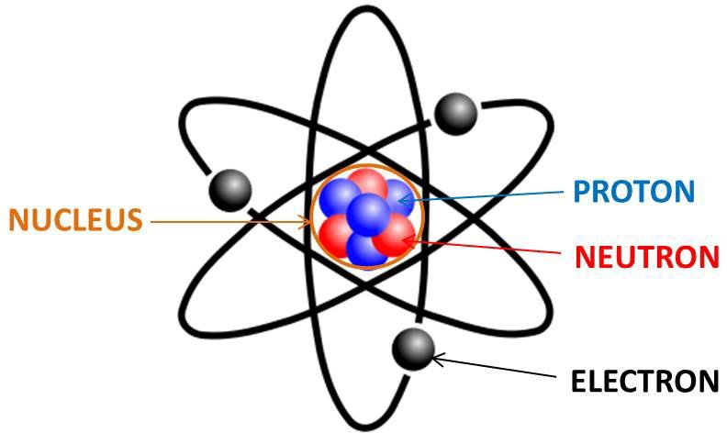
What is Physics?
… to the smallest …

Slide 5
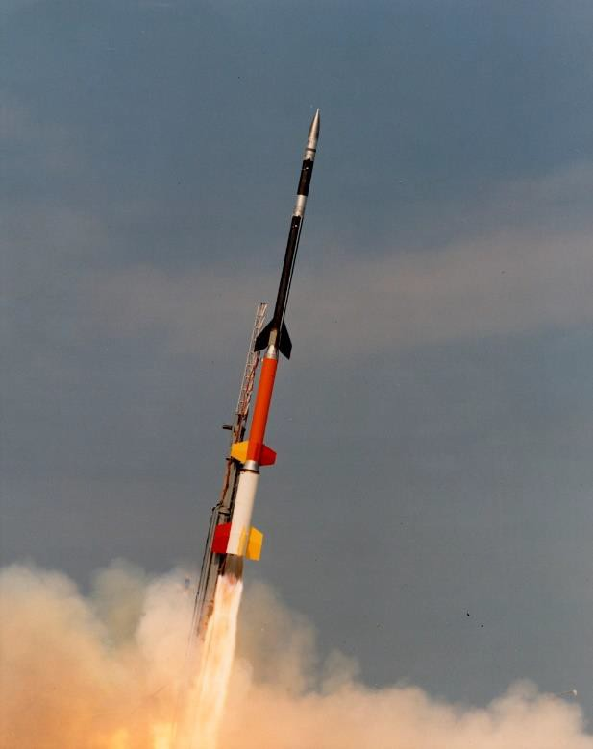
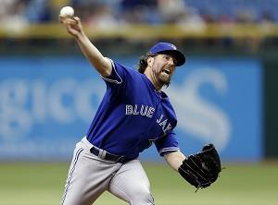
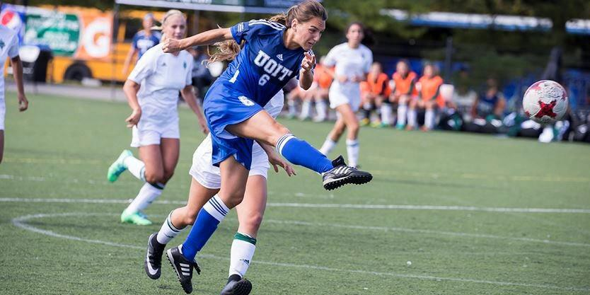
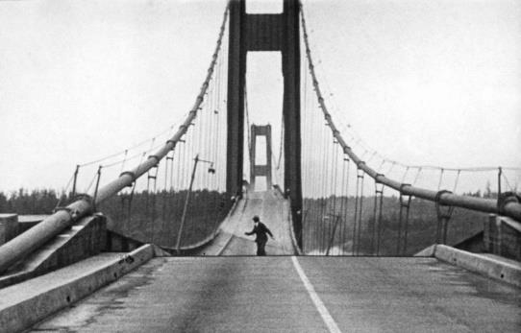
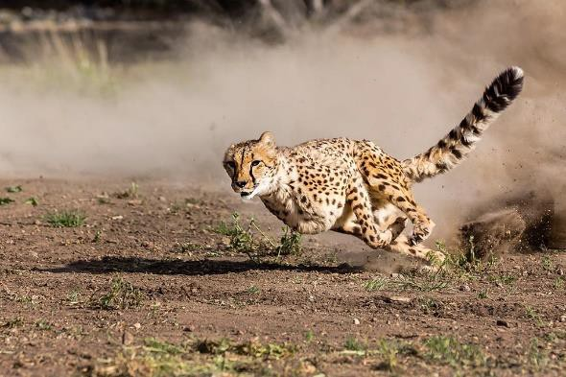
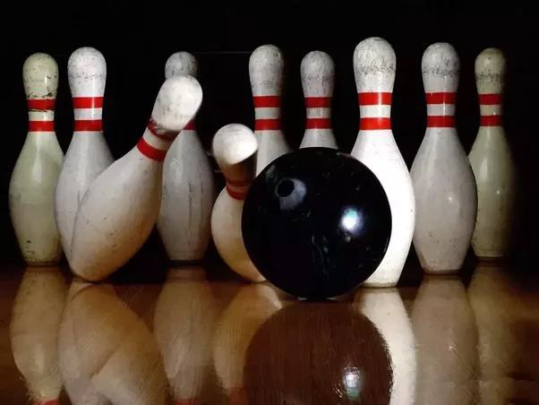
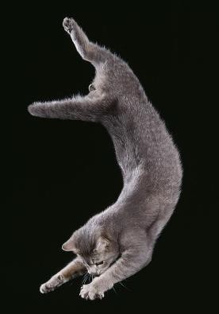
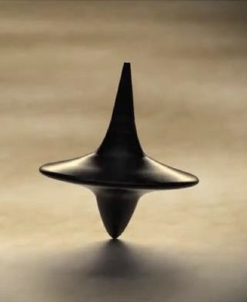
What is Physics?
… and everything in between …

Slide 6
What is Physics?
… physics is the study of it all.

Slide 7
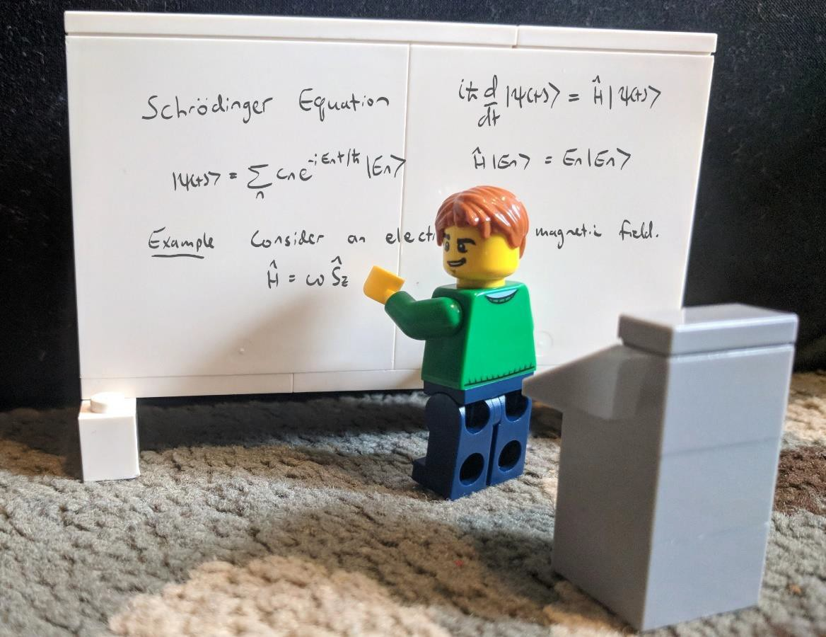
About Me
Dr. Franco Gaspari
Professor
Office: UA 4022
Email: franco.gaspari@uoit.ca
Research Interests
Nanoscience, photovoltaics (solar energy), smart materials, forensic physics.

Slide 8


About You
I’d like to ask some questions. Since this is a big class, we can use technology to ask everybody at once.
-> rwpoll.com
Enter the session ID I’ll show in a moment.

Slide 9
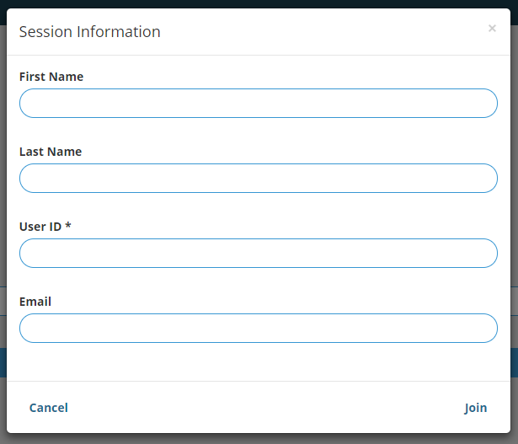

Answering Questions
You must have your correct
student ID in the “User ID” box for me to calculate your final participation marks.
You can create an account if you like so you don’t have to keep putting in your student number.
Click “Sign In” at the top of the screen.

Slide 10
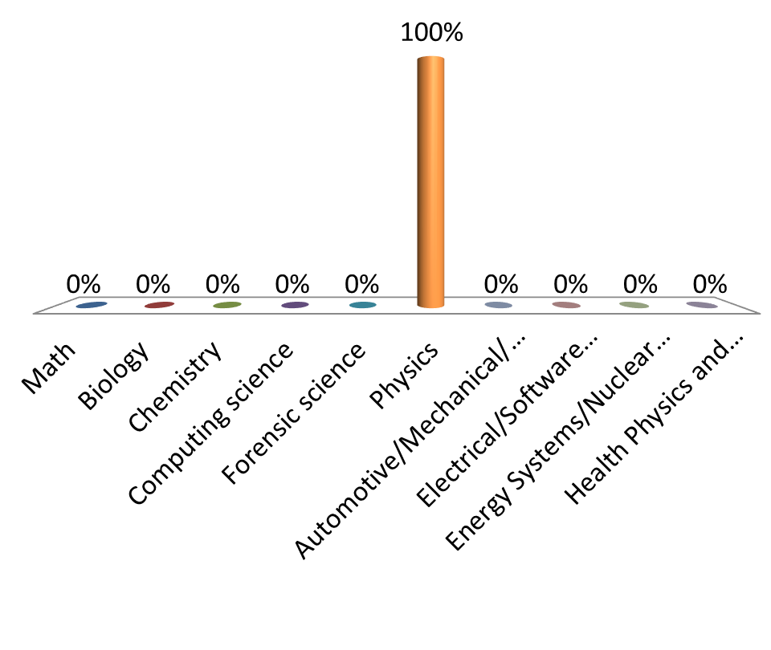
What program are you in?
Math
Biology
Chemistry
Computing science
Forensic science
Physics
Automotive/Mechanical/Manufacturing/Mechatronics Engineering
Electrical/Software engineering
Energy Systems/Nuclear engineering
Health Physics and Radiation/Nuclear Power

Slide 11
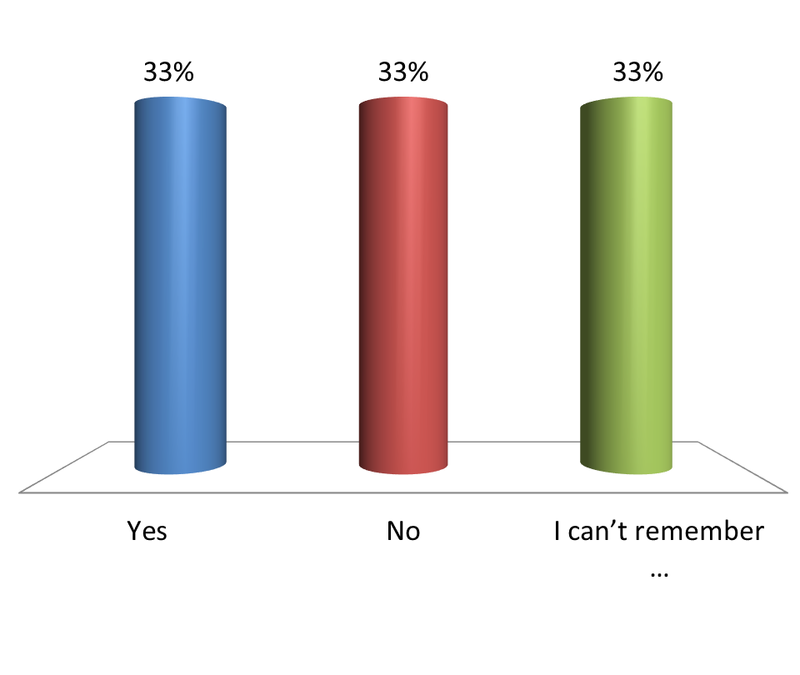
Did you take grade 12 physics?
Yes
No
I can’t remember …

Slide 12
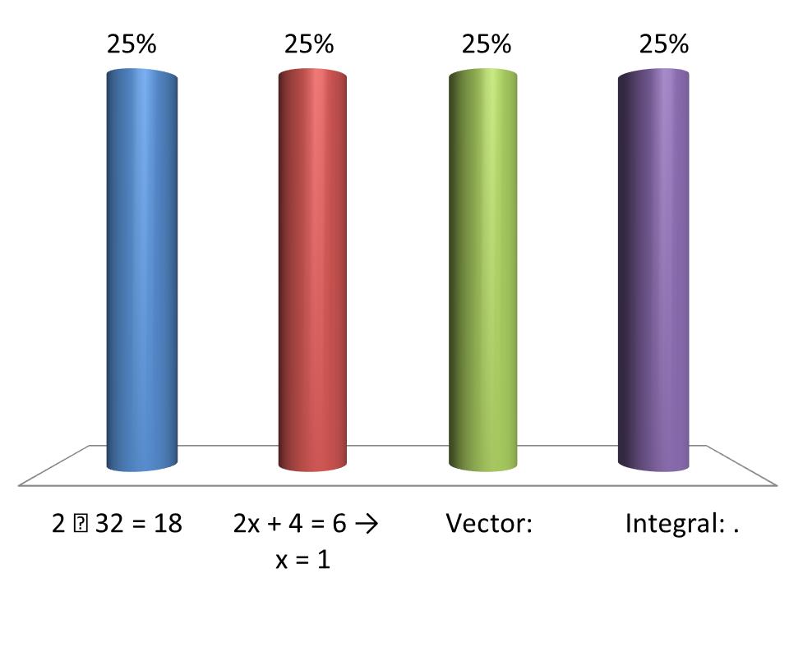


How much math do you know?
2 × 3² = 18
2x + 4 = 6 → x = 1
Vector:
Integral: .

Slide 13
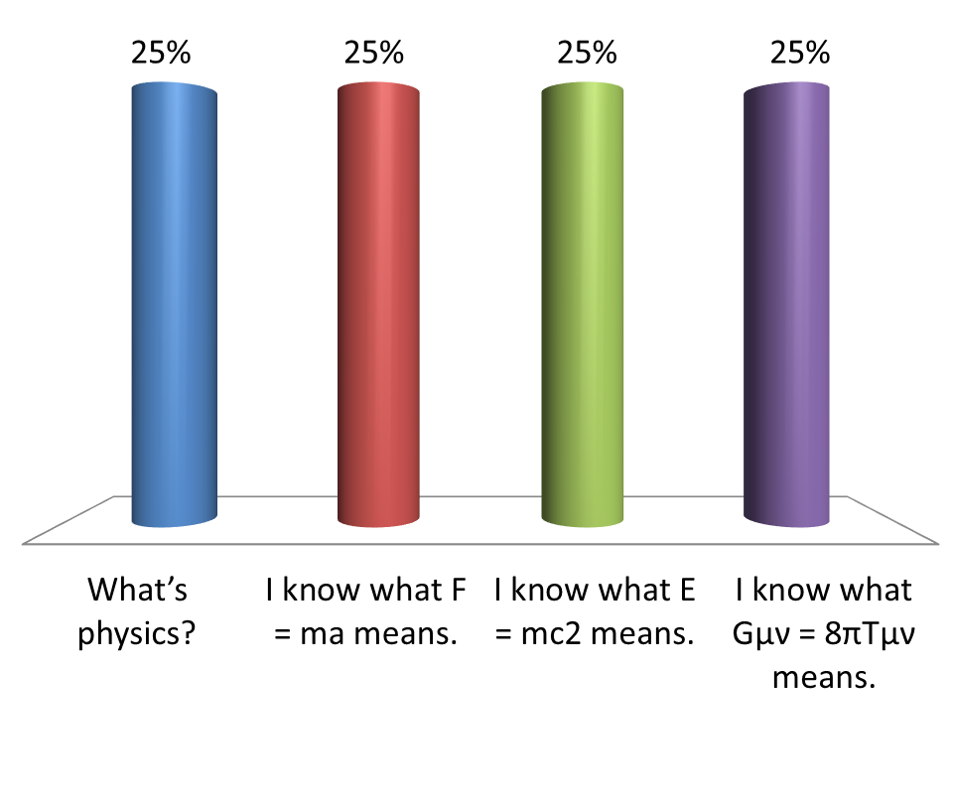
How much physics do you know?
What’s physics?
I know what F = ma means.
I know what E = mc² means.
I know what G_{µν} = 8πT_{µν} means.

Slide 14
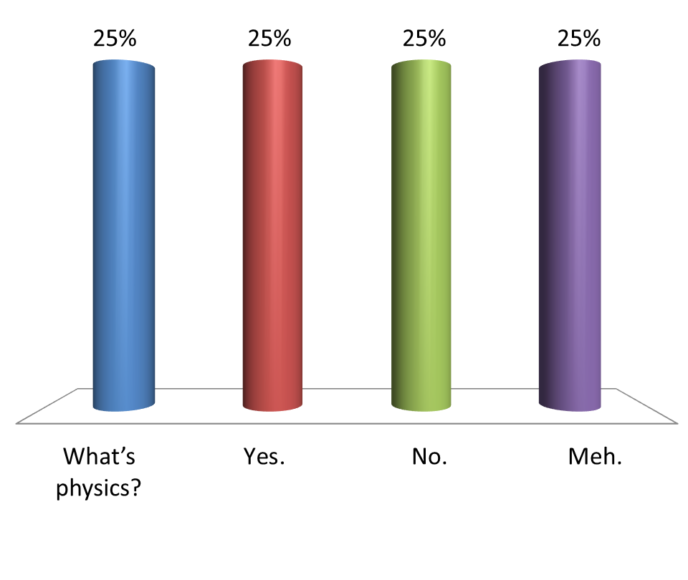
Do you like physics?
What’s physics?
Yes.
No.
Meh.

Slide 15

Do you like physics?
What’s physics?
Yes.
No.
Meh.

Slide 16
The Course Syllabus
It’s on Blackboard, it’s long and boring and very important to read. But I’ll give you a few highlights.

Slide 17
Lectures
You’re in one now!
Bring a device to answer questions with and some paper and a
pen or pencil.
Physics education research shows that lectures are not useful
for learning unless students are actively engaged.
Before lecture: read/watch videos, answer pre-lecture
questions.

Slide 18
Tutorials
Tutorials will start Thursday, September 12. No tutorials before then, even if they’re on your schedule.
The tutorials are a chance to work on problems in small groups and get feedback from your Teaching Assistant.
At the end of the tutorial, you’ll hand in your solution to a problem for grading.

Slide 19
Laboratories
Labs will start Monday, September 16.
A full schedule of all lab times will be posted on Blackboard, as
well as more info about lab expectations.

Slide 20
Textbook
Physics for Scientists and Engineers by Randall D. Knight (Fourth Edition).
Also used in Physics II and Physics for Biosciences. You do not need MasteringPhysics.com access codes.

Slide 21
Marking Scheme
Labs*: 20%
Pre-lecture quizzes: 2%
In-class participation: 2%
Mastery Modules (LON-CAPA): 8%
Tutorial tests: 8%
Tests (3 total): 20%
Final examination: 40%
*To pass: get at least 50% and pass the lab component.

Slide 22
LON-CAPA
Some course content will be LON-CAPA:
Mastery Modules
Pre-lecture quizzes (first one due before next class!)

Slide 23
Physics
Fundamental Science
concerned with the basic principles of the Universe
foundation of other physical sciences
Divided into six major areas
Classical Mechanics
Relativity
Thermodynamics
Electromagnetism
Optics
Quantum Mechanics

Slide 24
Mechanics: the branch of physics concerned with the motion of bodies
Motion of an object (from atomic particle to galaxies) and the forces acting on it
Fundamental Laws (only three) of mechanics govern the above motion
Our goal: Classical (or Newtonian) mechanics and its applications

Slide 25
Theory and Experiments
Should complement each other
When a discrepancy occurs, theory may be modified
Theory may apply to limited conditions
Example: Newtonian Mechanics is confined to objects traveling slowing with respect to the speed of light
Try to develop a more general theory

Slide 26
Vectors and Scalars
Vector quantities need both magnitude (size or numerical value) and direction to completely describe them
Will use + and – signs to indicate vector directions
Scalar quantities are completely described by magnitude only
More on vectors later

Slide 27
One-Dimensional Motion
From simple to complex: we live in three dimensions. We start, however, with the motion in ONE dimension
Displacement: Δx = x₂ - x₁
Time to travel: Δt = t₂ - t₁
Average velocity: v_{av}=Δx/Δt

Slide 28
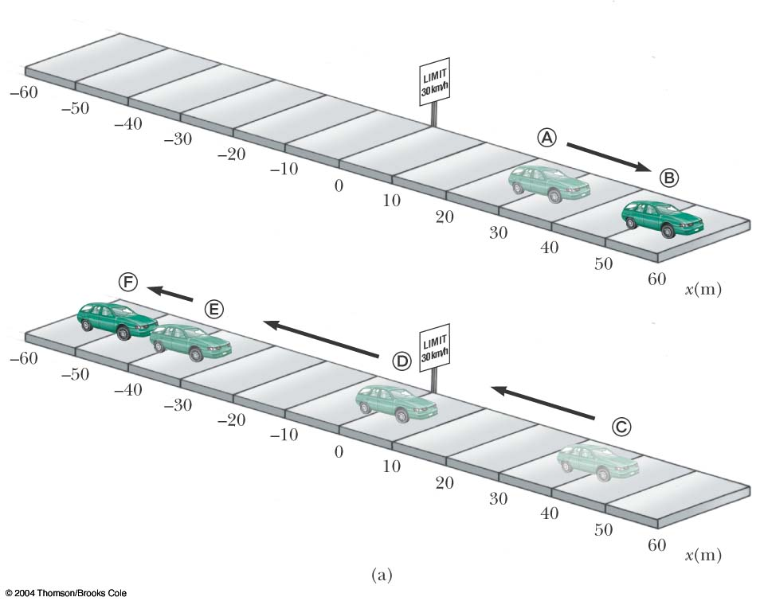

Slide 29
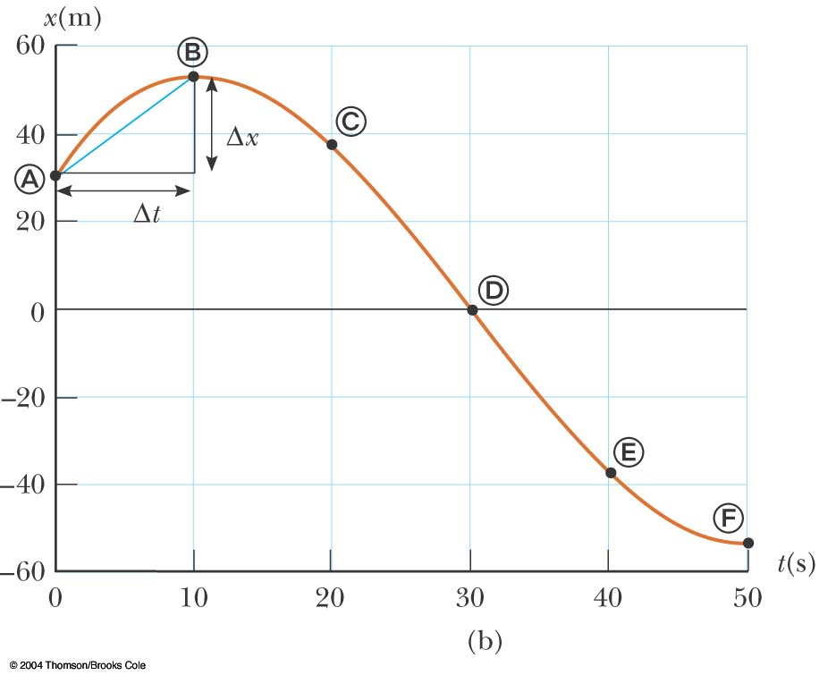
Position-Time Graph
The position-time graph shows the motion of the particle (car)
The smooth curve is a guess as to what happened between the data points

Slide 30
Displacement
Defined as the change in position during some time interval Δt
Represented as Δx
Δx = x_{f} - x_{i}
SI units are meters (m) Δx can be positive or negative
Different than distance – the length of a path followed by a particle

Slide 31
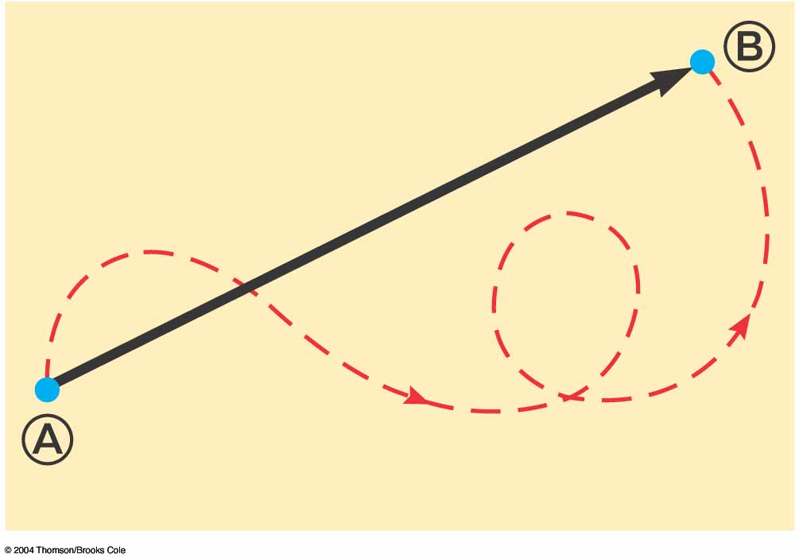
Reminder: Vector Example
A particle travels from A to B along the path shown by the dotted red line
This is the distance traveled and is a scalar
The displacement is the solid line from A to B
The displacement is independent of the path taken between the two points
Displacement is a vector

Slide 32
Average Velocity
The average velocity is rate at which the displacement occurs
The dimensions are length / time [L/T] (review dimensional analysis from textbook)
The SI units are m/s
Is also the slope of the line in the position – time graph
There is a difference between Velocity and Speed

Slide 33
Average Speed
Speed is a scalar quantity
same units as velocity
total distance / total time
The average speed is not (necessarily) the magnitude of the average velocity

Slide 34
One-Dimensional Motion
Average velocity: v_{av}=Δx/Δt=
= (displacement)/(elapsed time)
Displacement and distance traveled are the same only if the object does not reverse direction

Slide 35
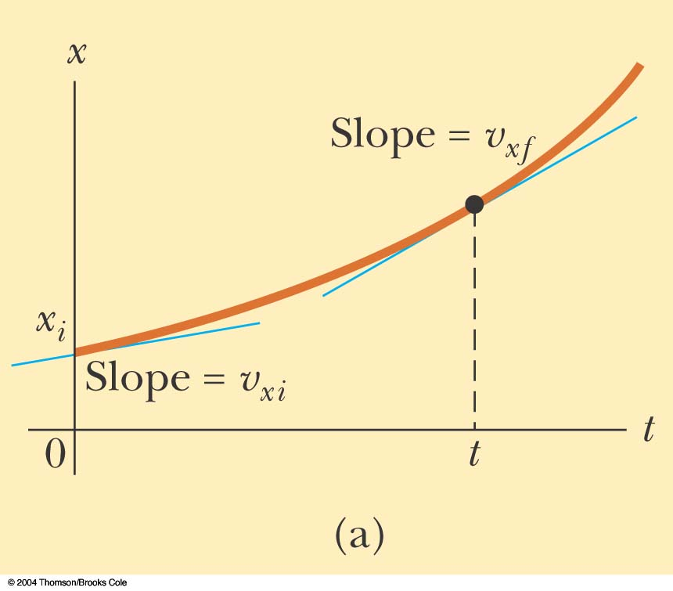
Example of motion
Notes:
Active Figure 2.10 A particle moving along the x axis with constant acceleration a_{x}; (a) the position-time graph.

Slide 36
Instantaneous velocity v
When Δ x and Δt become smaller and smaller we can define the limit:

Slide 37
Uniform motion
Uniform motion is occurring at constant velocity
that is, at (i) constant speed
and in a (ii) straight line
Uniform motion: Δx=v Δt
x₂=x₁+v(t₂-t₁)

Slide 38
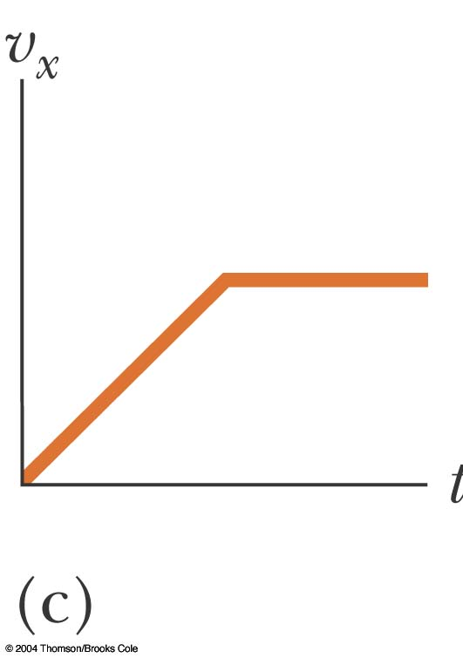
Where is the uniform motion?
Fig. 2.11c, p.37
Notes:
Active Figure 2.11 Parts (a), (b), and (c) are v_{x}-t graphs of objects in one-dimensional motion.

Slide 39
Nonuniform motion
Nonuniform motion: (i) a magnitude of a velocity v or/and (ii) a direction of the motion are changing in time.
In one dimension: only (i) is applicable
Acceleration: a_{av}=(v₂-v₁)/(t₂-t₁) =Δv/Δt
Instantaneous acceleration is a limit of the above when Δv and Δt are very small

Slide 40
Where is the nonuniform motion?
Fig. 2.11c, p.37
Notes:
Active Figure 2.11 Parts (a), (b), and (c) are v_{x}-t graphs of objects in one-dimensional motion.

Slide 41
Coordinate Systems
Used to describe the position of a point in space
Coordinate system consists of
a fixed reference point called the origin
specific axes with scales and labels
instructions on how to label a point relative to the origin and the axes

Slide 42
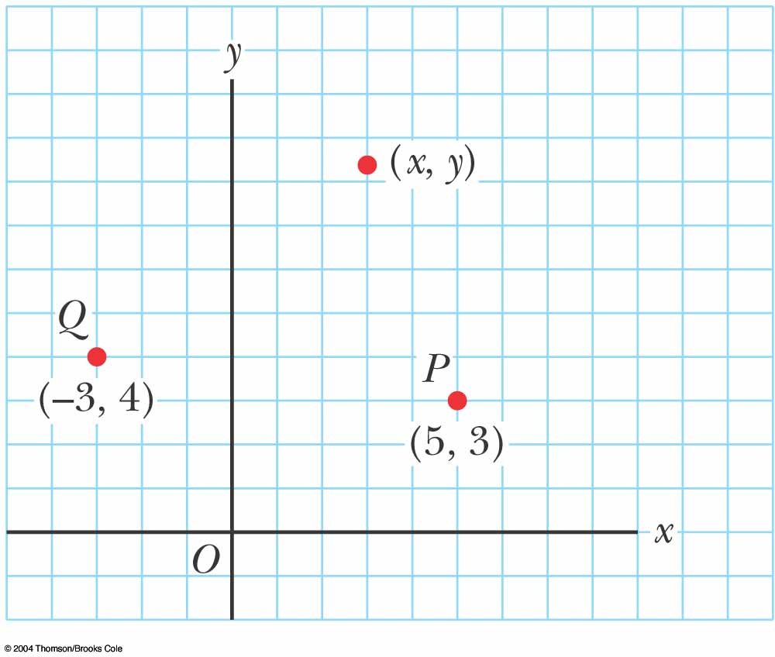
Cartesian Coordinate System
Also called rectangular coordinate system
x- and y- axes intersect at the origin
Points are labeled (x,y)

Slide 43
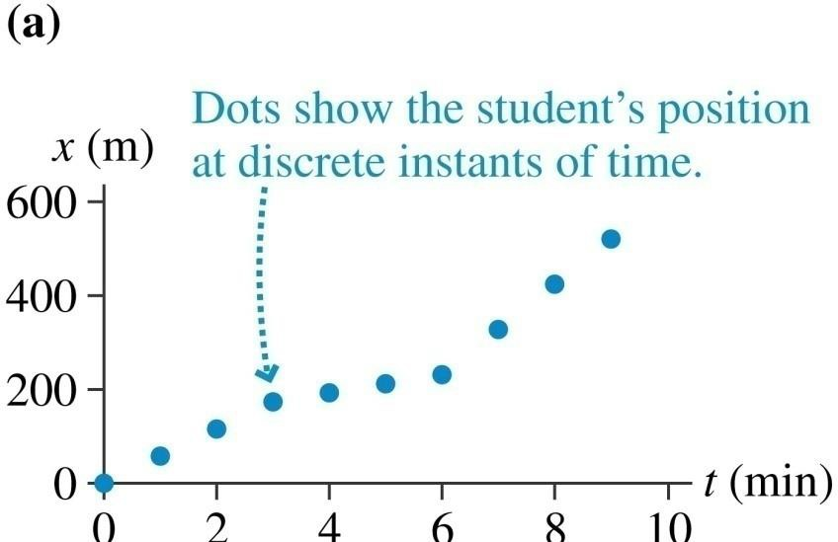
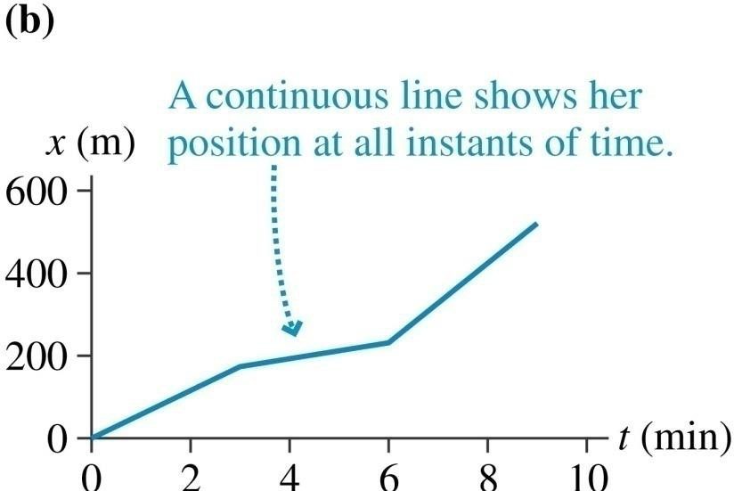
Position-Versus-Time Graphs
Consider a graph of a student walking to school:

Slide 44
Motion with constant velocity
If the velocity of an object is constant, how do we describe its motion
mathematically?

Slide 45
Motion with constant acceleration
What if the velocity is always changing but the acceleration is constant?

Slide 46
Motion with constant acceleration

Slide 47

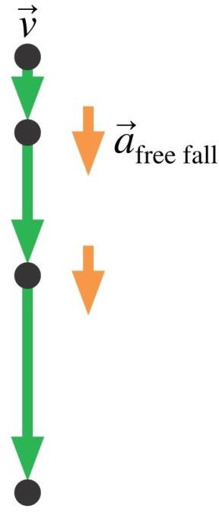
Free fall
The magnitude of the free fall acceleration is given the symbol g:
Note that:
g is always positive! It’s the magnitude of the free fall acceleration. So
g is not called “gravity.”
g = 9.80 m/s² only on Earth.

Slide 48

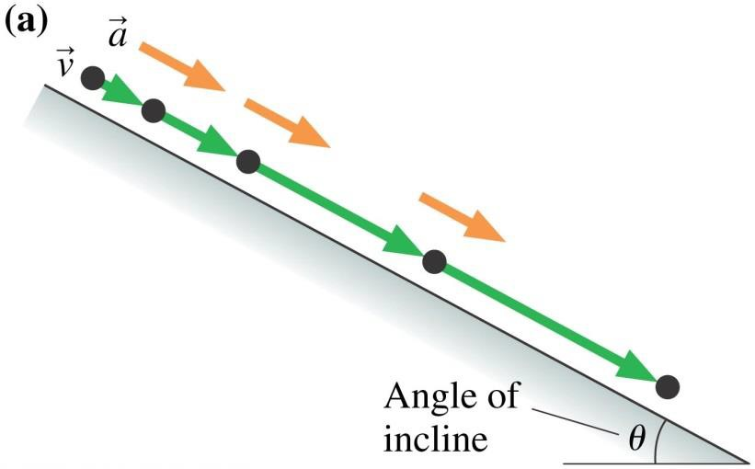
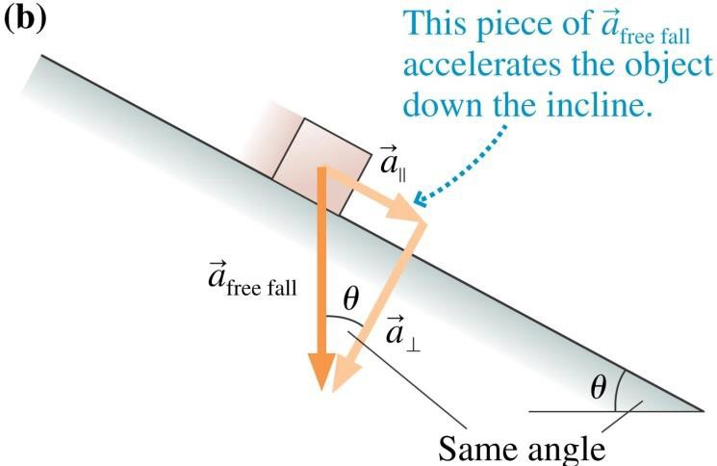
Inclined Motion
On an inclined plane, an object will have acceleration
The sign depends on the direction the ramp is tilted.

Slide 49
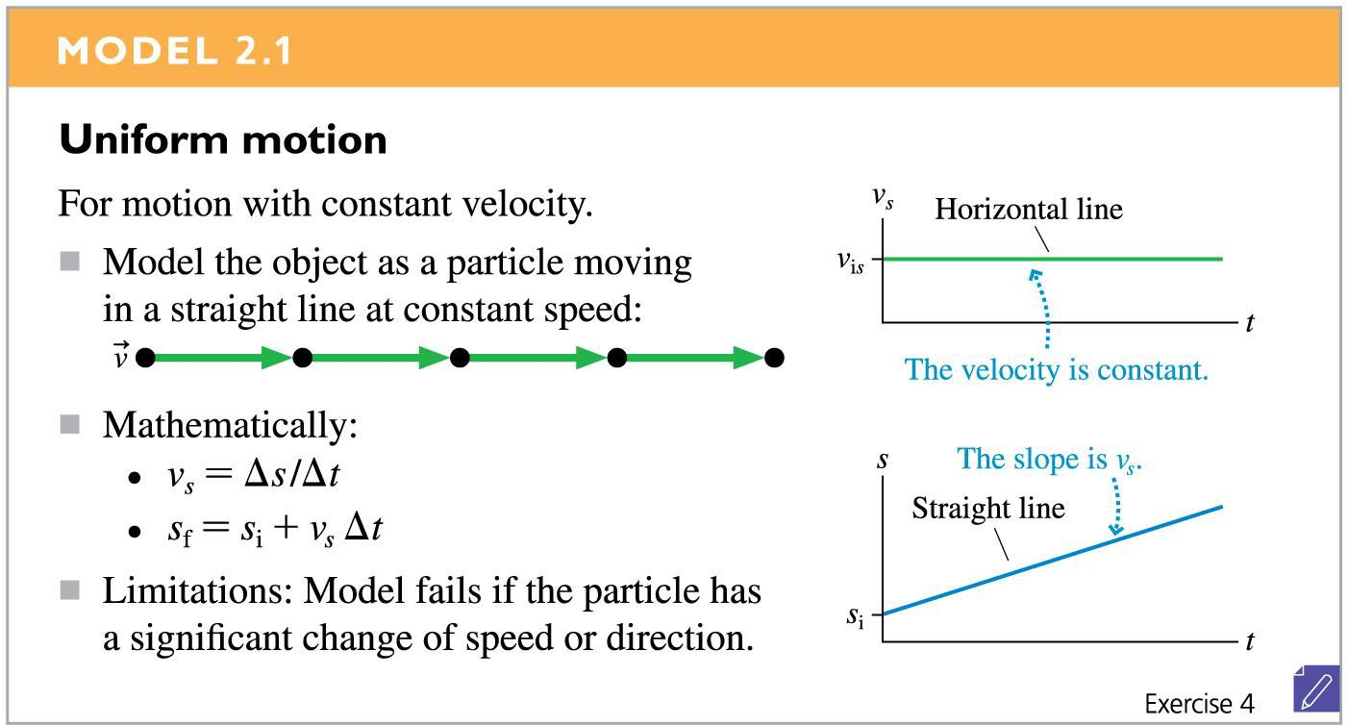
Motion with constant velocity

Slide 50
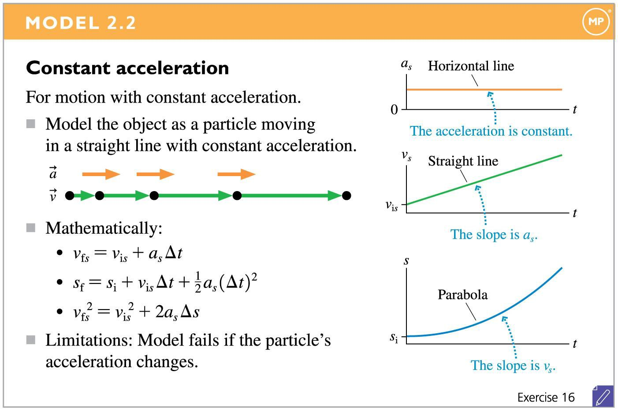
Motion with constant acceleration

Slide 51
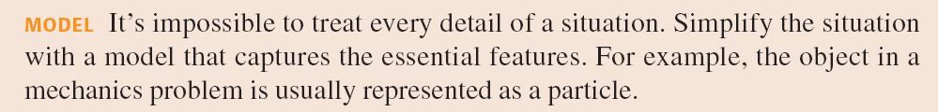
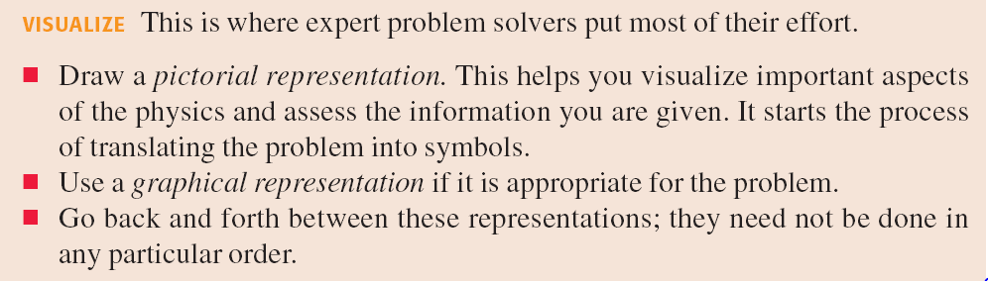
Problem Solving

Slide 52
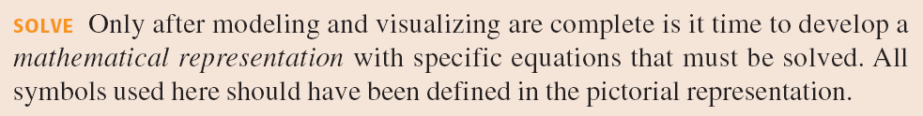
Problem Solving

